Slide 1
LEO Microsatellite Station-Keeping
Ion Propulsion with Solar Collector Technology
550 km Orbit Analysis | April 2026

Slide 2
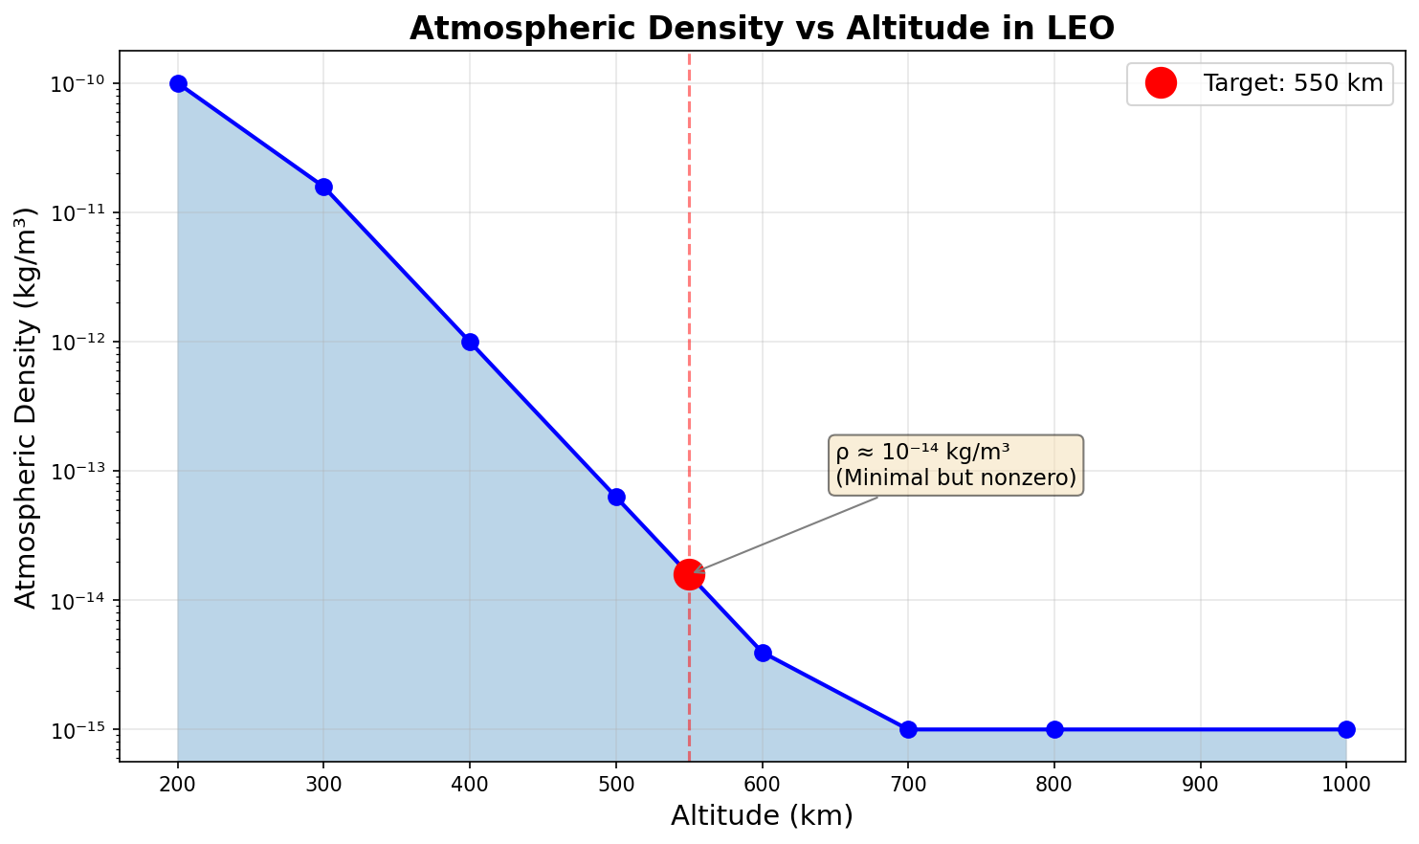
The Problem: LEO Drag at 550 km
• Atmosphere doesn't end at space edge - thin but present
• 550 km density: ~10⁻¹⁴ kg/m³ (minimal but nonzero)
• Orbital velocity: 7.6 km/s (high kinetic energy)
• Drag force: ~0.001-0.01 N for typical microsat
• Result: 0.5-5 meters/day altitude loss
• Solar activity amplifies drag 10x during maximum
• Without correction: eventual orbital decay

Slide 3
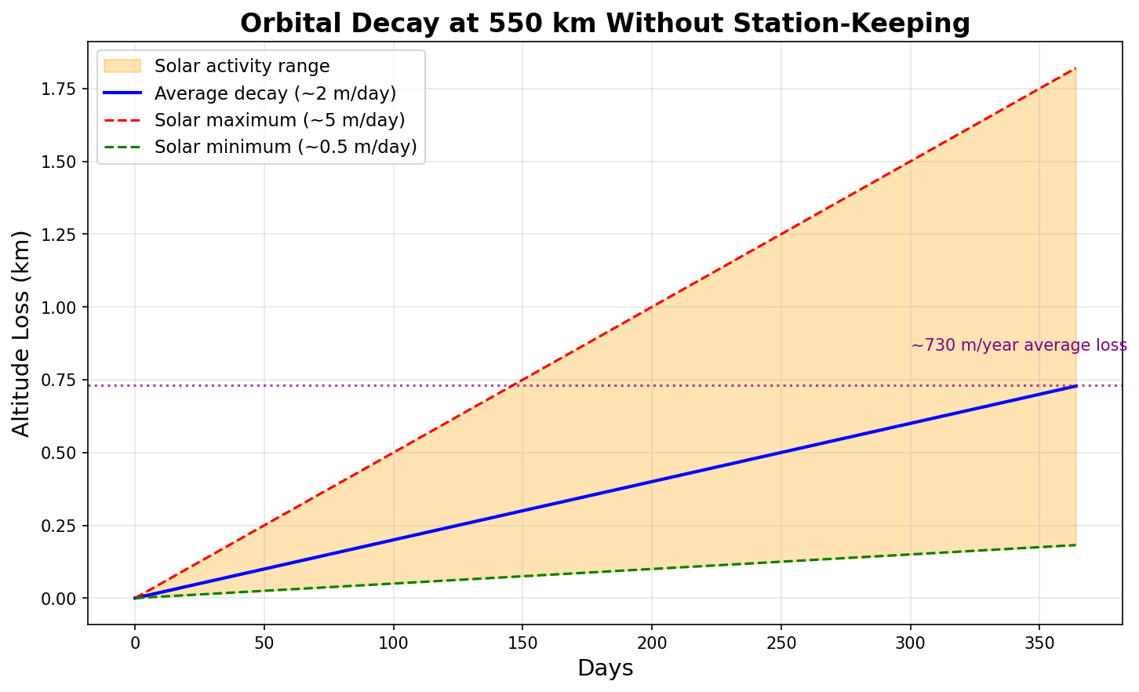
Orbital Decay Without Station-Keeping
Average decay: ~730 meters/year. Solar maximum can triple this rate.

Slide 4
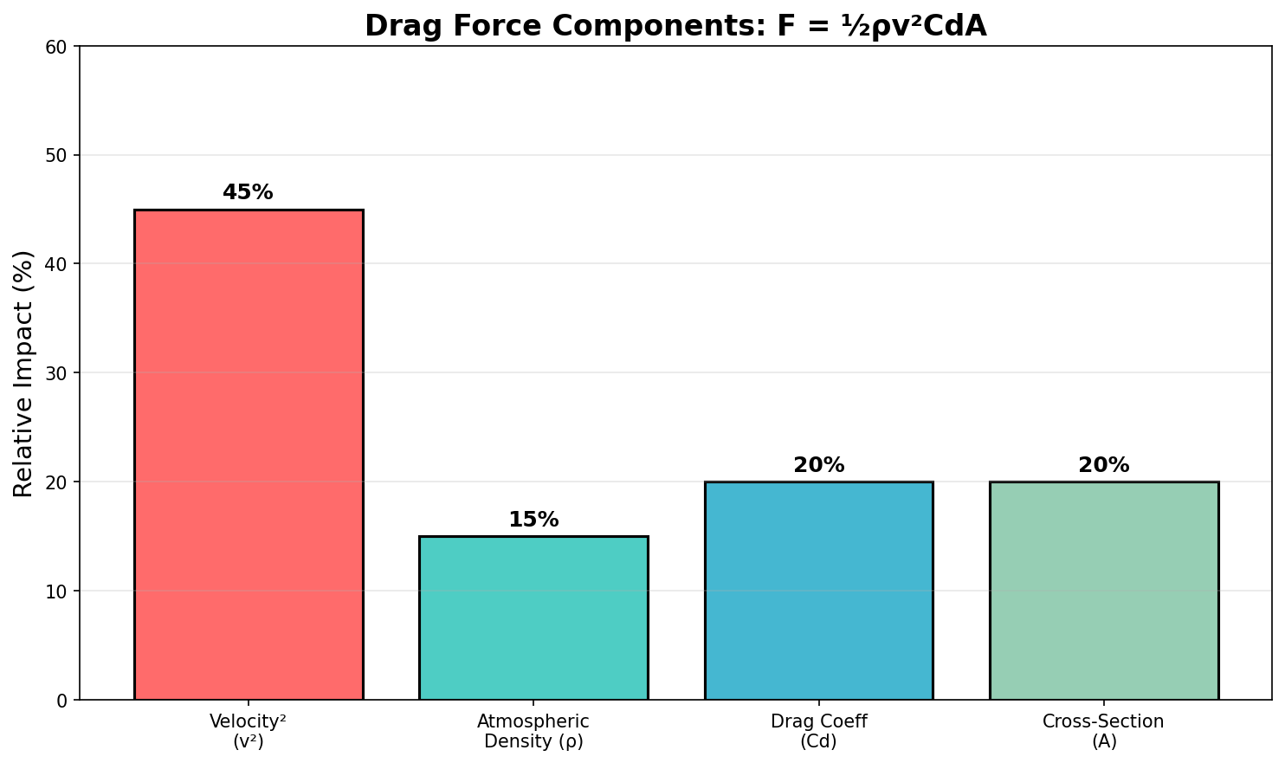
Understanding Drag Force Components
F_drag = ½ρv²CdA — Velocity squared is the dominant factor

Slide 5
Solution: Ion Propulsion Station-Keeping
• Why Ion Propulsion?
• - Specific impulse: 1500-3000s (vs 300s chemical)
• - Fuel efficiency: 10x less propellant needed
• - Continuous low thrust ideal for drag compensation
•
• Why Solar Collectors?
• - Ion thrusters need 100-500W continuous power
• - 550 km orbit: 60 min sun, 36 min eclipse
• - Modern solar arrays: 20-30% efficiency
• - Enables 5+ year mission without refueling

Slide 6
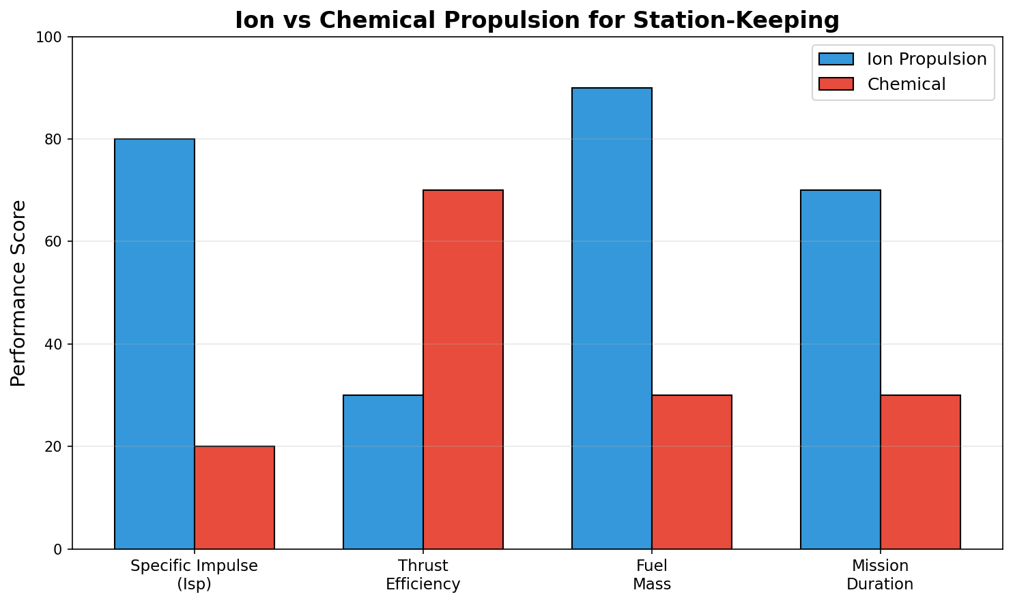
Ion vs Chemical Propulsion
Ion propulsion: Superior efficiency for long-duration station-keeping missions

Slide 7
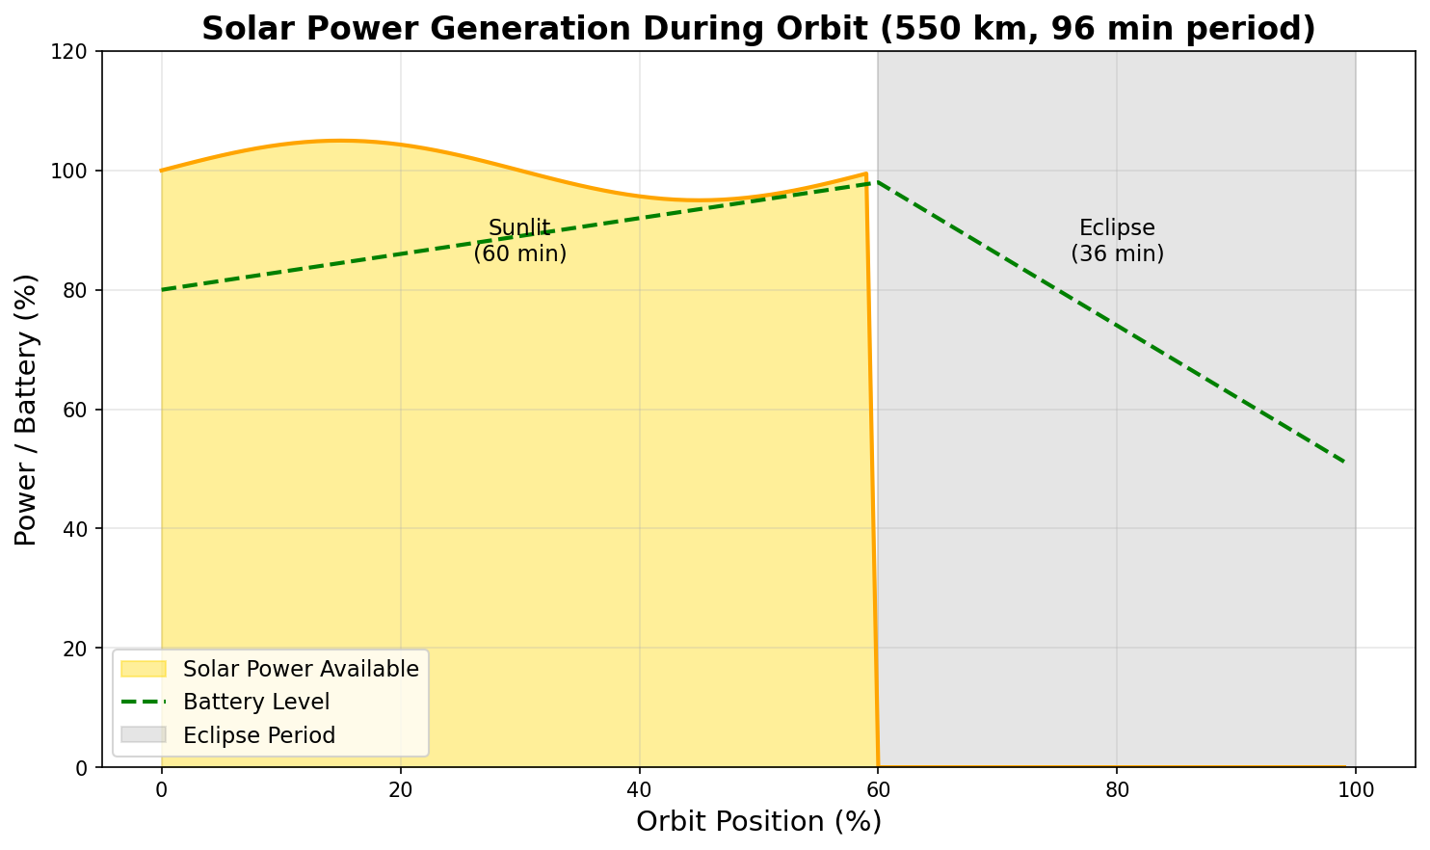
Solar Power Generation Profile
Orbital period: 96 minutes. Battery required for 36-minute eclipse.

Slide 8
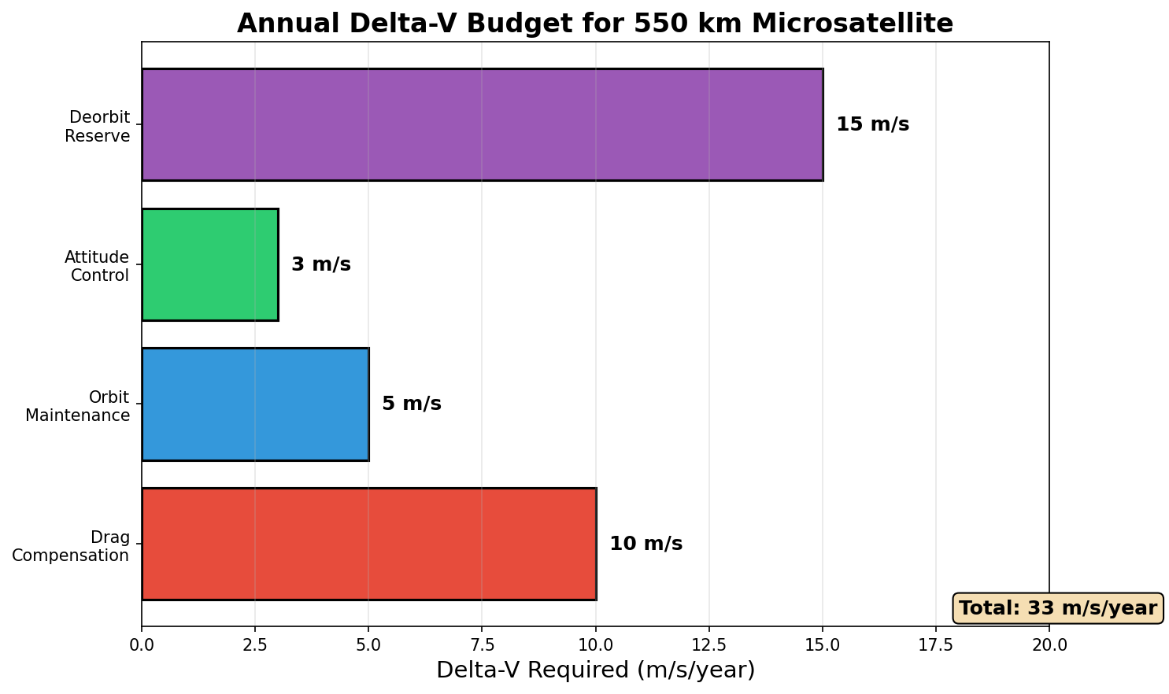
Annual Delta-V Requirements
Total: ~33 m/s/year. Ion thruster can provide this with <100g propellant.

Slide 9
Microsatellite System Design
• MASS BUDGET (10 kg class):
• - Solar arrays: 1.5 kg (deployable, 200W)
• - Ion thruster: 0.8 kg (Hall or electrospray)
• - Propellant: 0.5 kg (Xenon or iodine)
• - Power system: 1.2 kg (battery + PPU)
• - Bus + payload: 6 kg
•
• KEY SPECIFICATIONS:
• - Thrust: 0.5-2 mN continuous
• - Isp: 2000s
• - Power: 150W (thrusting)
• - Mission life: 5+ years

Slide 10
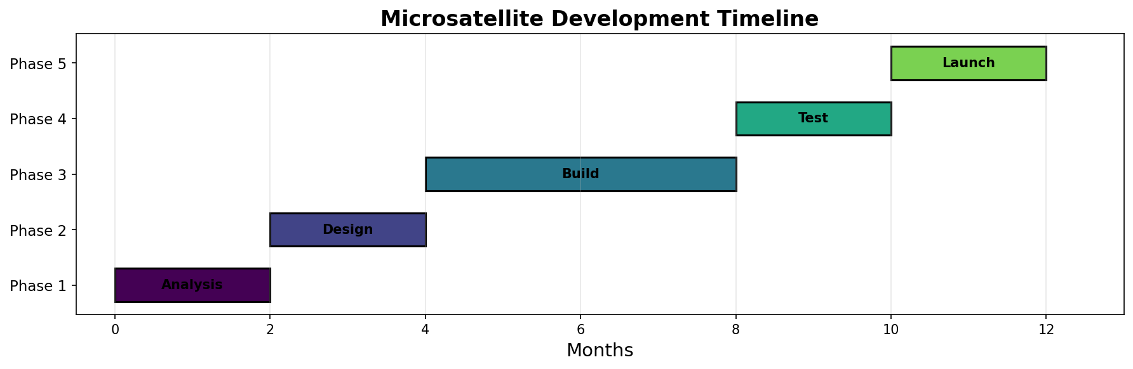
Development Timeline
12-month development cycle from analysis to launch readiness

Slide 11
Cost-Benefit Analysis
• ION PROPULSION SYSTEM:
• - Thruster hardware: $50-150k
• - Propellant (Xenon): $5k/kg
• - Power system: $30-50k
• - Total add: ~$150-250k
•
• OPERATIONAL BENEFITS:
• - 5+ year mission vs 1-2 years
• - No collision avoidance fuel reserve needed
• - Precise orbit maintenance ±1 km
• - Lower per-year operational cost
•
• ROI: Extended mission pays for itself

Slide 12
Key Recommendations
• 1. SELECT HALL-EFFECT THRUSTER
• Proven technology, 1500-2000s Isp, simple integration
•
• 2. USE IODINE PROPELLANT
• Cheaper than Xenon, solid storage, compact
•
• 3. OVERSIZE SOLAR ARRAYS
• 20% margin for degradation over mission life
•
• 4. IMPLEMENT AUTOMATED STATION-KEEPING
• Ground commands weekly, onboard autonomy daily
•
• 5. PLAN FOR SOLAR MAXIMUM
• Increased drag budget for 2025-2027 period

Slide 13
Conclusion
• 550 km orbit: minimal but real atmospheric drag
• Ion propulsion + solar collectors = efficient station-keeping
• Small microsatellites can maintain orbit for 5+ years
• Technology is mature and cost-effective
• Key is right-sizing power and propulsion systems
Solar-powered ion propulsion enables affordable, long-duration LEO missions.

